Slide 1
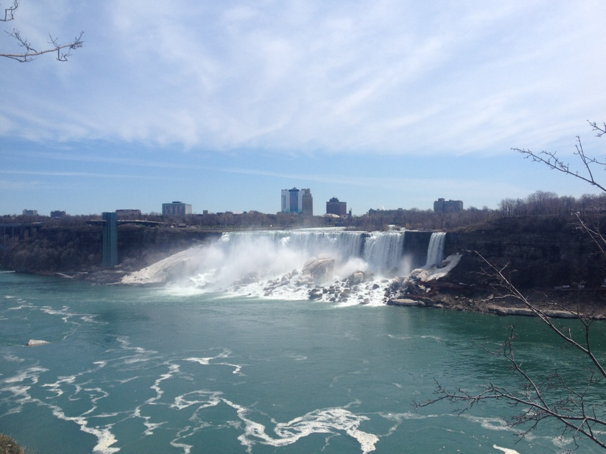
专业英语
自动化工程学院
夏琳琳
prettylin521@aliyun.com
15044219407

Slide 2
应用文体写作-Cover Letter
Notes:
求职信

Slide 3
    Cover letters.
    As much as they require more work, cover letters are a great opportunity to cover qualifications we can’t fully explain in our resumes. And, they help personalize job applicants to enable them to come across more as real people to potential employers. If you throw together a cover letter in the hopes that nobody will actually read it, you might be missing a chance to land the job. To take advantage of a cover letter's full potential, follow these steps below. You’ll find advice on formatting, reviewing, and researching cover letters. You will also find links to three free samples which you can copy and adapt to your own personal cover letter.

Slide 4
    Cover Letter Template
    Salutation
    Dear [insert name of hiring manager],
    Body
    First paragraph: Mention the job you’re applying for and where you found the job listing.
    Middle paragraphs: Discuss your qualifications. These paragraphs should be specifically tailored to requirements posted in the job listing. You might also consider including why this specific company interested you in the first place. Limit this section to two to three paragraphs.
    Final paragraph: Discuss the next steps. If you are going to follow up in one to two weeks, mention a specific date. If you would prefer to leave the ball in their court, say that you look forward to discussing your qualifications further. Also provide your email address and phone number. Don’t forget to thank them for their time.
    Close
    Best,
    [insert your name]

Slide 5
应用文体写作-Application Letter

Slide 6
Format --- type 1
Introduction: 3ws ; expected study time
Body:
1. a brief introduction of yourself
2. reasons for applying (focus)
3. mention your resume & letter of recommendation included (brief)
Conclusion: ask for consideration ; your thanks

Slide 7
Useful expressions --- introduction
I am writing to enquire whether you think it would be possible for me to study under you beginning on August 26th.
I am writing to you in the hope of obtaining an opportunity to do some research work in your department / lab.
I am greatly interested in….. And hope that I may ….(do my Ph.D. work ) under your instruction.
I would like to apply for a place at…for further studies.
I am writing to you about the possibility of a visiting scholar’s appointment in your department.
I wish to apply for admission to your… to do my research work.
I hope to obtain your permission to….
I will certainly feel greatly honored if I am fortunate enough to be admitted into ….

Slide 8
Lines of thinking
Reasons ---
enjoy world fame / good reputation --- leading professors; advanced facilities;
is a well staffed and well-equipped institute with a long history and a fine tradition of scholarship
be closely related to your research area / research interest / focus / direction
eager to learn some cutting-edge knowledge from him / her, such as advanced research methods, up-to- date academic results, etc.
get varied experience coupled with opportunities for advancement in your academic work
have the opportunity to exchange ideas with some top researchers in the world / area
communication will contribute to the cooperation between our two universities.

Slide 9
Expressions used in resume
Enclosed here is my resume / cv. As you will see from my resume that……
Enclosed please find a brief resume of…
Attached here is my resume.
I am enclosing a copy of my resume.

Slide 10
Useful expressions --- conclusion
I hope you would consider my application and give me a reply at your earliest convenience.
Thank you for your time and consideration. I look forward to your reply.
I should be much obliged if you accord me an opportunity to work under you.
Your prompt attention to my application would be highly appreciated.
I am looking forward to a favorable response.

Slide 11
Useful expressions & words
apply for; applicant ; admission to..
educational background ; graduate from; diploma; be awarded the degree of ;
working experience; be qualified; be competent at ; have a good command of;
make outstanding achievements in sth ;

Slide 12
In-class writing
You want to obtain a one-year grant to do research work at an overseas university . Write an application letter, seeking to be given this opportunity. In your letter, you should:
1. give a brief introduction of yourself
2. state your reasons for study there
3. express your thanks for consideration
Write at least 100 wds.

